Slide 1

CSE 4000: Project/Thesis
Vehicular Network Security Improvement by Emphasizing Malicious Data Classification Using Cascaded Machine Learning Approach
Presented By:
Name: Argha Chandra Dhar Name: Arna Roy
Roll: 1707069 Roll: 1707018
Supervised By:
Dr. Md. Aminul Haque Akhand
Professor
Department of Computer Science and Engineering
Khulna University of Engineering & Technology, Khulna

Slide 2

Outline
Background Study
Methodology
Experimental Studies
Conclusions
References

Slide 3

Background Study

Slide 4
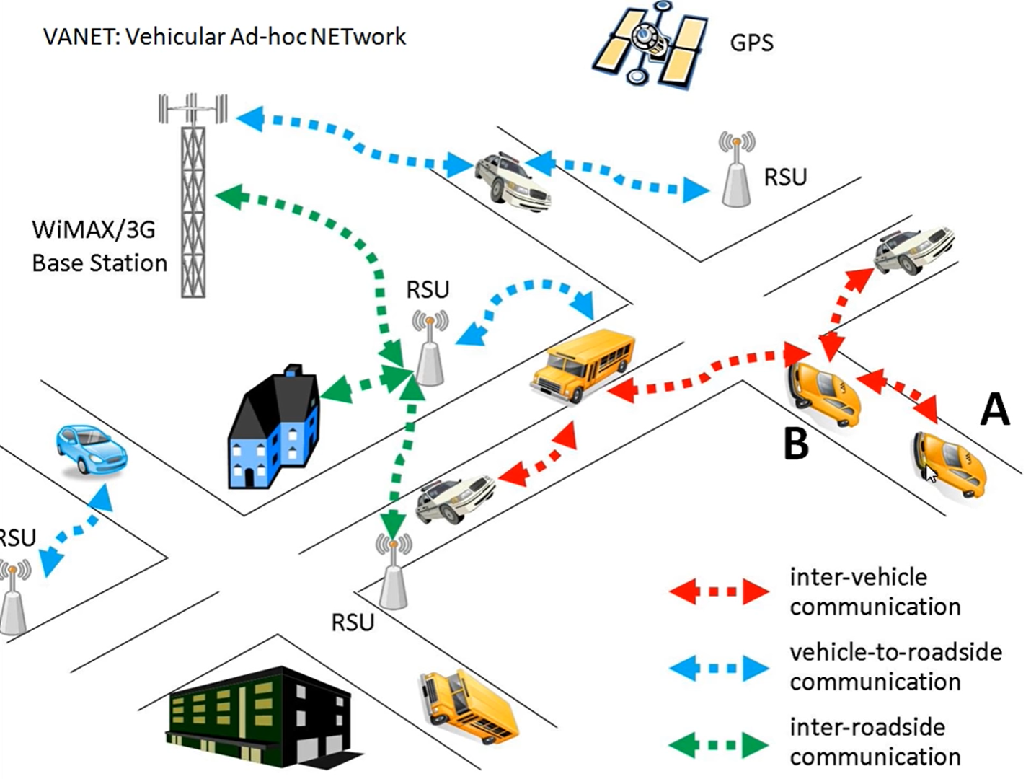
Vehicular Network
Vehicular Ad Hoc Networks (VANETs).
Wireless network to the domain of vehicles.
Known as car-to-car ad-hoc mobile communication.
Responsible for the communication between moving vehicles.
Frequent exchange of information.
Figure 1: A VANET Model.

Slide 5
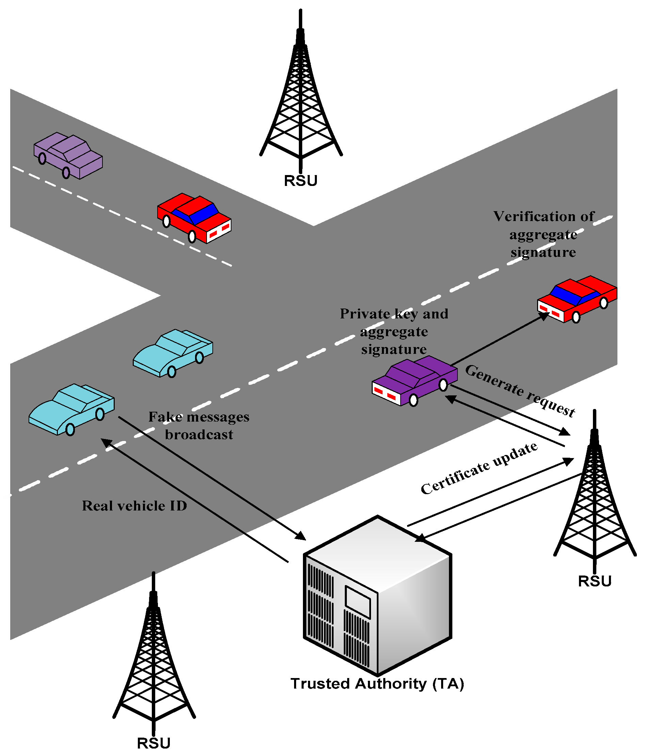
Security in VANET
High chances of threat to privacy.
Intrusion easy due to frequently changing topology.
High mobility and wireless media usage make VANET vulnerable.
Different attacks such as: Impersonation, Denial of services, Hijacking, False Information etc.
Intrusion Detection Systems (IDS) identify malicious activity in the network.
Figure 2: A VANET Security Model.

Slide 6






Security Breach and Consequences
Road Side Unit
No Signal!!!
Jam Area
Warning!!! Accidents
A

Slide 7
Prominent Works on VANET Security
Authors, Year | Paper title | Methods
Song at al., 2020 [1] | In-vehicle network intrusion detection using deep convolutional neural network | Convolutional Neural Network (CNN)
Ullah et al., 2022 [2] | HDL-IDS: A Hybrid Deep Learning Architecture for Intrusion Detection in the Internet of Vehicles | LSTM + GRU hybrid model
Nazakat and Khurshid, 2019 [3] | Intrusion Detection System for In-Vehicular Communication | Decision Tree
Barletta et al., 2020 [4] | Intrusion Detection for in-Vehicle Communication Networks: An Unsupervised Kohonen SOM Approach | Self Organized Map
Ashraf et al., 2021 [5] | Novel Deep Learning-Enabled LSTM Autoencoder Architecture for Discovering Anomalous Events From Intelligent Transportation Systems | LSTM + Autoencoder

Slide 8


Shortcomings of Other Works
No work on the perspective of Bangladesh
Existing methods are complex
No attack emphasize

Slide 9

Motivations for this Work
Cascaded Machine Learning (ML) Model emphasis on learning attacks in two a step process
Attention given not to misclassify attacks as Normal
Simple ML model with different framework
Proposed system would be applicable in Bangladesh under certain conditions
Before going to main Methodology, we tried NSL-KDD and simulated own dataset

Slide 10

Methodology

Slide 11
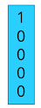

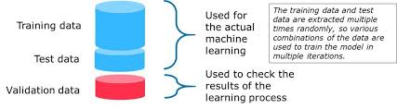

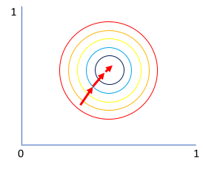

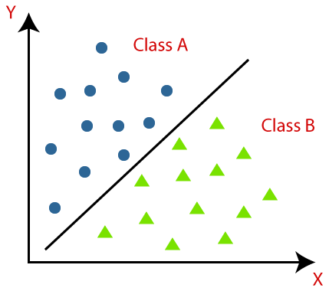
The Procedure of the Experiment
Data Preprocessing
80%
20%
Invalid Data Remove
Normalizing
One hot Encoding
Car Hacking Dataset
Splitting
Single ML Model
Cascaded ML Model
Prediction
Training
The Cascaded ML Model is the proposed model

Slide 12
Working Technique for the Proposed Model
Major Class Classification
Sub Class Classification
DoS Attack
ML_{Attack}
Gear Attack
ML_{Main}
Output Class
Training Stage
RPM Attack
Train Data
Attack Data
Fuzzy Attack
Data
Normal Data
DoS Attack
ML_{Main}
ML_{Attack}
Gear Attack
Attack Data
Test Data
Recognition Stage
RPM Attack
Fuzzy Attack
Figure 3: Proposed Cascaded Framework Architecture.

Slide 13
Working Technique for the Proposed Model (Cont.)
Normal Data
ML_{Attack}
DoS
ML_{Main}
Gear
RPM
Attack Data
Fuzzy

Slide 14

Working Technique for the Proposed Model (Cont.)
Neural Network at the core of the Model
9 input features and three hidden layers with 50,20 and 10 neurons
Size of output layer based on attack types

Slide 15

Experimental Studies

Slide 16
Dataset Description
Table 1: Attributes and Number of Samples in Car Hacking [7] Dataset.
Attack Names | Timestamp | CAN ID | Number of Data Bytes | Data [0-7] | Output Class | Number of Samples
Normal | -- | Random hex value | 0-8 (but all are 8) | Data value | T (Normal Data) | 988872
Denial of Service (DoS) | Every 0.3 millisecond | Dominant value “0000” | 0-8 (but all are 8) | Data value | R (Injected Data) | 587521
Gear Attack (Spoofing type) | Every 1 millisecond | Random hex value | 0-8 (but all are 8) | Data value | R (Injected Data) | 597252
RPM Attack (Spoofing Type) | Every 1 millisecond | Random hex value | 0-8 (but all are 8) | Data value | R (Injected Data) | 654897
Fuzzy Attack | Every 0.5 millisecond | Random hex value | 0-8 (but all are 8) | Data value | R (Injected Data) | 491847

Slide 17
Experimental Results and Analysis
Table 2: Overall Performance of the Two Implemented Models.
Model | Precision (%) | Recall (%) | F1 Score (%) | Accuracy (%)
Single ML Model | 99.98 | 99.98 | 99.98 | 99.98
Cascaded ML Model | 99.98 | 99.99 | 99.98 | 99.99
Improvement is minimal but significant in terms of VANET security

Slide 18
Experimental Results and Analysis (Cont.)
Table 3: Confusion Matrix for Single ML Model.
Attacks | Normal | DoS | Fuzzy | Gear | RPM | Misclassified as Normal | Misclassified as Other Classes | Total
Normal | 185623 | 0 | 4 | 0 | 1 | 0 | 5 | 185628
DoS | 0 | 117505 | 0 | 0 | 0 | 0 | 0 | 117505
Fuzzy | 85 | 0 | 98277 | 0 | 8 | 85 | 8 | 98370
Gear | 0 | 0 | 0 | 119451 | 0 | 0 | 0 | 119451
RPM | 0 | 0 | 0 | 0 | 130978 | 0 | 0 | 130978
 |  |  |  |  | Total | 85 | 13 | 651932

Slide 19
Experimental Results and Analysis (Cont.)
Table 4: Confusion Matrix for Cascaded ML Model.
Attacks | Normal | DoS | Fuzzy | Gear | RPM | Misclassified as Normal | Misclassified as Other Classes | Total
Normal | 185628 | 0 | 0 | 0 | 0 | 0 | 0 | 185628
DoS | 0 | 117505 | 0 | 0 | 0 | 0 | 0 | 117505
Fuzzy | 61 | 0 | 98309 | 0 | 0 | 61 | 0 | 98370
Gear | 0 | 0 | 0 | 119451 | 0 | 0 | 0 | 119451
RPM | 0 | 0 | 0 | 0 | 130978 | 0 | 0 | 130978
 |  |  |  |  | Total | 61 | 0 | 651932
Attack misclassified as Normal was reduced to 61 and Overall misclassification was also reduced

Slide 20
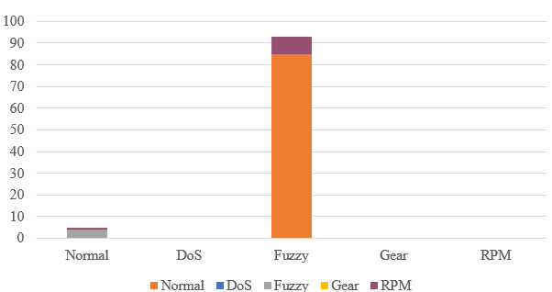
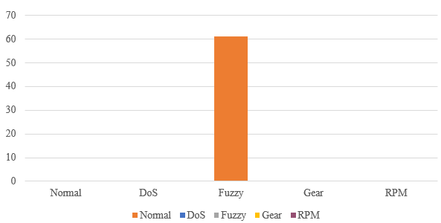
Experimental Results and Analysis (Cont.)
Figure 4: Misclassification Chart for Single ML Model.
Figure 5: Misclassification Chart for Cascaded ML Model.

Slide 21
Experimental Results and Analysis (Cont.)
Table 5: Performance Comparison of Proposed Model with State-of-Art Models.
Work Ref. | Method | Test Data for Performance Evaluation | Accuracy | Level of Classification | Attack Emphasized
[2] | Hybrid model (LSTM + GRU) | 20% of combined Car Hacking and DDoS Dataset | 99.70% | Major Class Only | No
[1] | Deep CNN | 30% of own generated dataset | Not Mentioned | Major Class Only | No
[6] | LSTM Autoencoder | 20% of the Car Hacking Dataset | 99% | Major Class Only | No
 |  | 20% of UNSW-NB15 | 98%
[7] | LSTM | Generated Dataset | 99.99% | Major Class Only | No
[4] | Unsupervised Kohonen Self-Organizing Map | 20% of the Car Hacking dataset | 99.88% | Major Class Only | No
Proposed Model | Single ML Model | 20% of the Total Car Hacking Dataset | 99.98% | Classification of Attacks and Major Attack Classes | Yes
 | Cascaded ML Model | 20% of the Total Car Hacking Dataset | 99.99%

Slide 22

Conclusions
Purpose is to build a network security system blended with a Machine Learning (ML) model.
Proposed Cascaded ML-based IDS in this study copes with a dataset by emphasizing that attacks should not go into the Normal class while classifying them further in attack levels.
Future work to use this model in real-time.
Here you go.
Thanks

Slide 23
References
H. M. Song, J. Woo, and H. K. Kim, “In-vehicle network intrusion detection using deep convolutional neural network,” Veh. Commun., vol. 21, p. 100198, Jan. 2020, doi: 10.1016/j.vehcom.2019.100198.
S. Ullah et al., “HDL-IDS: A Hybrid Deep Learning Architecture for Intrusion Detection in the Internet of Vehicles,” Sensors, vol. 22, no. 4, p. 1340, Feb. 2022, doi: 10.3390/s22041340.
I. Nazakat and K. Khurshid, “Intrusion Detection System for In-Vehicular Communication,” in 2019 15th International Conference on Emerging Technologies (ICET), Dec. 2019, pp. 1–6, doi: 10.1109/ICET48972.2019.8994327.
V. S. Barletta, D. Caivano, A. Nannavecchia, and M. Scalera, “Intrusion Detection for in-Vehicle Communication Networks: An Unsupervised Kohonen SOM Approach,” Futur. Internet, vol. 12, no. 7, p. 119, Jul. 2020, doi: 10.3390/fi12070119.
J. Ashraf, A. D. Bakhshi, N. Moustafa, H. Khurshid, A. Javed, and A. Beheshti, “Novel Deep Learning-Enabled LSTM Autoencoder Architecture for Discovering Anomalous Events From Intelligent Transportation Systems,” IEEE Trans. Intell. Transp. Syst., vol. 22, no. 7, pp. 4507–4518, Jul. 2021, doi: 10.1109/TITS.2020.3017882.
M. D. Hossain, H. Inoue, H. Ochiai, D. Fall, and Y. Kadobayashi, “LSTM-Based Intrusion Detection System for In-Vehicle Can Bus Communications,” IEEE Access, vol. 8, pp. 185489–185502, 2020, doi: 10.1109/ACCESS.2020.3029307.
E. Seo, H. M. Song, and H. K. Kim, “GIDS: GAN based Intrusion Detection System for In-Vehicle Network,” in 2018 16th Annual Conference on Privacy, Security and Trust (PST), Aug. 2018, pp. 1–6, doi: 10.1109/PST.2018.8514157.
https://www.flaticon.com/.
https://www.sciencedirect.com/topics/computer-science/vehicular-ad-hoc-network.

Slide 24
Thank You
Q/A

